Slide 1
Department of Applied Mathematics and Computational Sciences
III Sem M.Sc.Software Systems
Transform Techniques
Dr. V. Suresh kumar

Slide 2
Transform of some simple functions

Slide 3
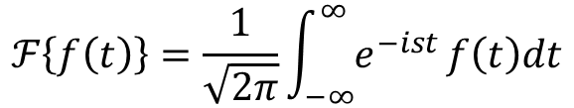
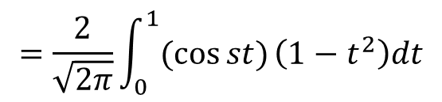
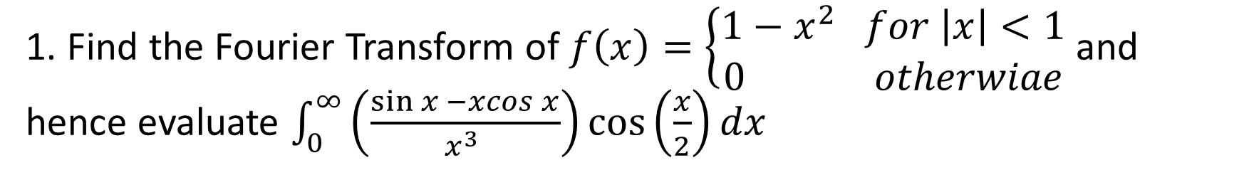
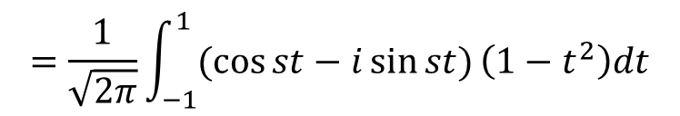
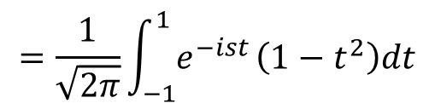

Example problem
1. Find the Fourier Transform of $f\left(x\right)=\left\{\begin{aligned}1−x^{2} for \left|x\right|<1 \\ 0 otherwiae\end{aligned} \right.$and hence evaluate $\int_{0}^{∞}{\left(\frac{\sin{x −xcos x}}{x^{3} }\right)\cos\left(\frac{x}{2}\right)dx}$
Ans:
We have
$$ℱ\left\{f\left(t\right)\right\}=\frac{1}{\sqrt{2π}}\int_{−∞}^{∞}{e^{−ist}}f\left(t\right)dt$$
$$f\left(t\right)=\left\{\begin{aligned}1−t^{2} if −1<t<1 \\ 0 otherwise\end{aligned} \right.$$
and
$$=\frac{1}{\sqrt{2π}}\int_{−1}^{1}{e^{−ist}}\left(1−t^{2}\right)dt$$
$$=\frac{1}{\sqrt{2π}}\int_{−1}^{1}{(\cos{st}−i\sin{st)}}\left(1−t^{2}\right)dt$$
$$=\frac{2}{\sqrt{2π}}\int_{0}^{1}{(\cos{st})}\left(1−t^{2}\right)dt$$

Slide 4
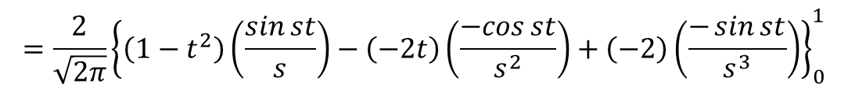
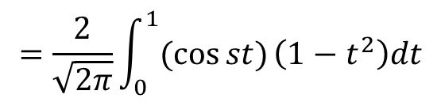
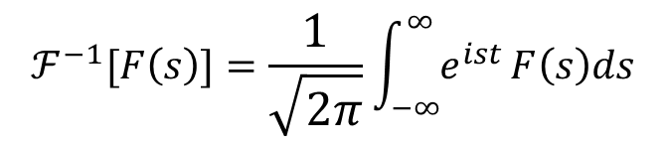
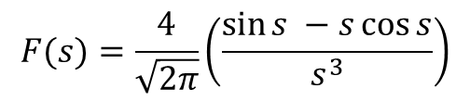
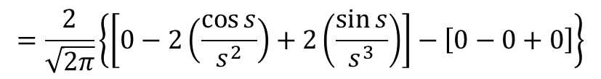
Example cont…
$$=\frac{2}{\sqrt{2π}}\int_{0}^{1}{(\cos{st})}\left(1−t^{2}\right)dt$$
$$=\frac{2}{\sqrt{2π}}{\left\{\left(1−t^{2}\right)\left(\frac{\sin{st}}{s}\right)−\left(−2t\right)\left(\frac{−cos{st}}{s^{2}}\right)+\left(−2\right)\left(\frac{−\sin{st}}{s^{3}}\right)\right\}}_{0}^{1}$$
$$=\frac{2}{\sqrt{2π}}\left\{\left[0−2\left(\frac{\cos{s}}{s^{2}}\right)+2\left(\frac{\sin{s}}{s^{3}}\right)\right]−\left[0−0+0\right]\right\}$$
$$F(s)=\frac{4}{\sqrt{2π}}\left(\frac{\sin{s −s\cos{s}}}{s^{3}}\right)$$
Deduction part
Using Inverse Fourier Transform
$$ℱ^{−1}[F\left(s\right)]=\frac{1}{\sqrt{2π}}\int_{−∞}^{∞}{e^{ist}}F\left(s\right)ds$$

Slide 5
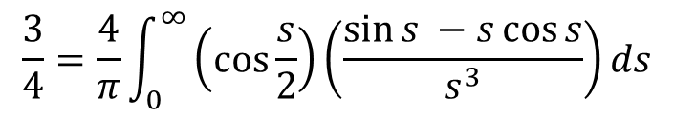
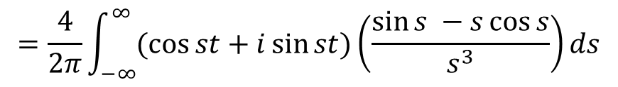
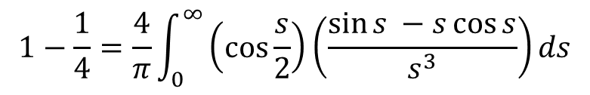
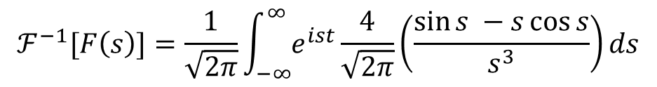
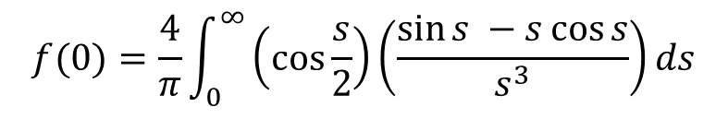

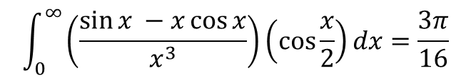
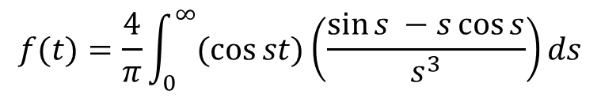
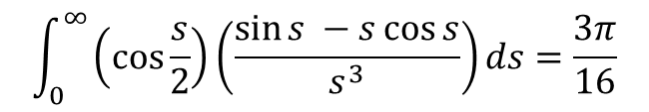
Example cont…
$$ℱ^{−1}[F\left(s\right)]=\frac{1}{\sqrt{2π}}\int_{−∞}^{∞}{e^{ist}}\frac{4}{\sqrt{2π}}\left(\frac{\sin{s −s\cos{s}}}{s^{3}}\right)ds$$
$$=\frac{4}{2π}\int_{−∞}^{∞}{(\cos{st+i\sin{st)}}}\left(\frac{\sin{s −s\cos{s}}}{s^{3}}\right)ds$$
$$\frac{3}{4}=\frac{4}{π}\int_{0}^{∞}{\left(\cos{\frac{s}{2}}\right)}\left(\frac{\sin{s −s\cos{s}}}{s^{3}}\right)ds$$
$$f(t)=\frac{4}{π}\int_{0}^{∞}{(\cos{st)}}\left(\frac{\sin{s −s\cos{s}}}{s^{3}}\right)ds$$
Put $t=\frac{1}{2}$
$$\int_{0}^{∞}{\left(\cos{\frac{s}{2}}\right)}\left(\frac{\sin{s −s\cos{s}}}{s^{3}}\right)ds=\frac{3π}{16}$$
$$f(0)=\frac{4}{π}\int_{0}^{∞}{\left(\cos{\frac{s}{2}}\right)}\left(\frac{\sin{s −s\cos{s}}}{s^{3}}\right)ds$$
$$\int_{0}^{∞}{\left(\frac{\sin{x −x\cos{x}}}{x^{3}}\right)\left(\cos{\frac{x}{2}}\right)}dx=\frac{3π}{16}$$
$$1−\frac{1}{4}=\frac{4}{π}\int_{0}^{∞}{\left(\cos{\frac{s}{2}}\right)}\left(\frac{\sin{s −s\cos{s}}}{s^{3}}\right)ds$$

Slide 6
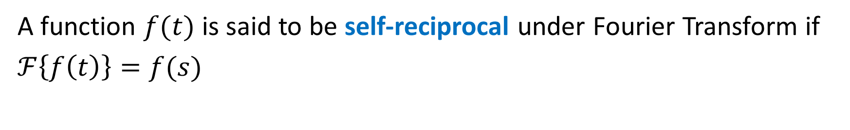
Definition
A function $f(t)$ is said to be self-reciprocal under Fourier Transform if
$ℱ\left\{f\left(t\right)\right\}=f(s)$

Slide 7
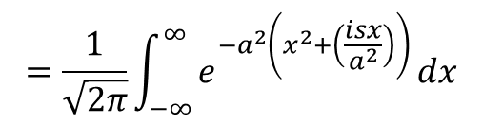
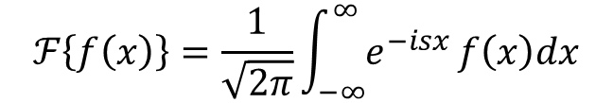
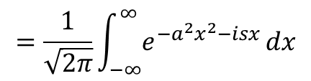
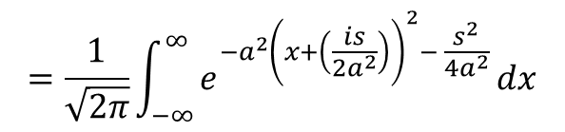
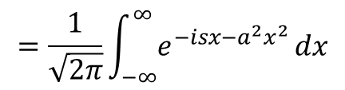
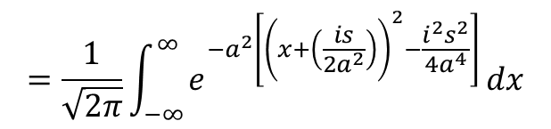
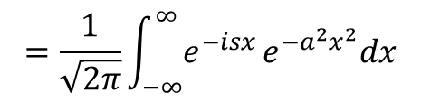
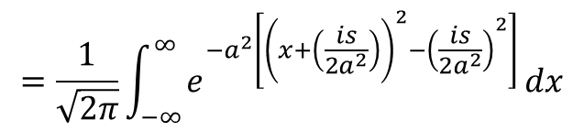

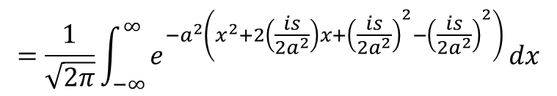
Example problem
2. Find the Fourier Transform of $f\left(x\right)=e^{{−a}^{2}x^{2}}, a>0$
Ans:
We have
$$ℱ\left\{f\left(x\right)\right\}=\frac{1}{\sqrt{2π}}\int_{−∞}^{∞}{e^{−isx}}f\left(x\right)dx$$
$$f\left(x\right)=e^{{−a}^{2}x^{2}}$$
and
$$=\frac{1}{\sqrt{2π}}\int_{−∞}^{∞}{e^{{−a}^{2}\left(x^{2}+2\left(\frac{is}{{2a}^{2}}\right)x+{\left(\frac{is}{{2a}^{2}}\right)}^{2}−{\left(\frac{is}{{2a}^{2}}\right)}^{2}\right)}}dx$$
$$=\frac{1}{\sqrt{2π}}\int_{−∞}^{∞}{e^{−isx}}e^{{−a}^{2}x^{2}}dx$$
$$=\frac{1}{\sqrt{2π}}\int_{−∞}^{∞}{e^{{−a}^{2}\left[{\left(x+\left(\frac{is}{{2a}^{2}}\right)\right)}^{2}−{\left(\frac{is}{{2a}^{2}}\right)}^{2}\right]}}dx$$
$$=\frac{1}{\sqrt{2π}}\int_{−∞}^{∞}{e^{−isx{−a}^{2}x^{2}}}dx$$
$$=\frac{1}{\sqrt{2π}}\int_{−∞}^{∞}{e^{{−a}^{2}\left[{\left(x+\left(\frac{is}{{2a}^{2}}\right)\right)}^{2}−\frac{i^{2}s^{2}}{{4a}^{4}}\right]}}dx$$
$$=\frac{1}{\sqrt{2π}}\int_{−∞}^{∞}{e^{{−a}^{2}x^{2}−isx}}dx$$
$$=\frac{1}{\sqrt{2π}}\int_{−∞}^{∞}{e^{{−a}^{2}\left(x^{2}+\left(\frac{isx}{a^{2}}\right)\right)}}dx$$
$$=\frac{1}{\sqrt{2π}}\int_{−∞}^{∞}{e^{{−a}^{2}{\left(x+\left(\frac{is}{{2a}^{2}}\right)\right)}^{2}− \frac{s^{2}}{{4a}^{2}}}}dx$$

Slide 8
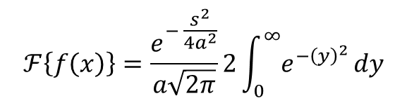
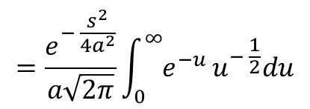
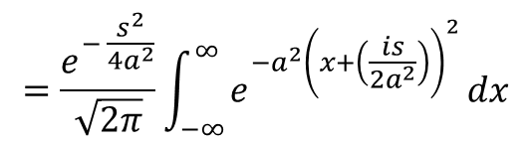
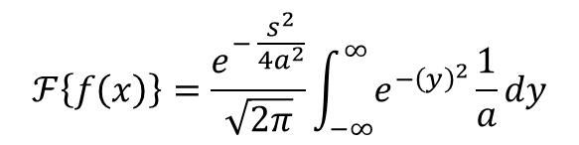
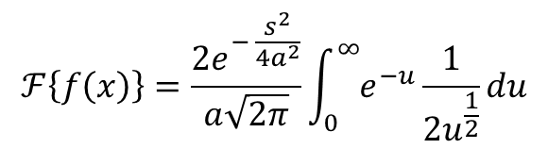
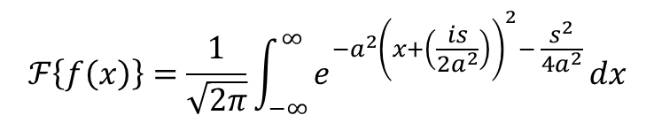
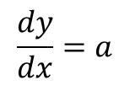
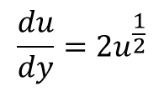
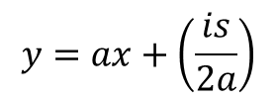
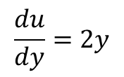
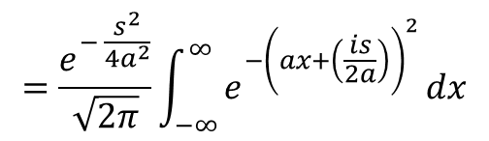

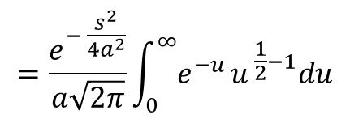
Example cont…
$$ℱ\left\{f\left(x\right)\right\}=\frac{1}{\sqrt{2π}}\int_{−∞}^{∞}{e^{{−a}^{2}{\left(x+\left(\frac{is}{{2a}^{2}}\right)\right)}^{2}− \frac{s^{2}}{{4a}^{2}}}}dx$$
$$ℱ\left\{f\left(x\right)\right\}=\frac{e^{− \frac{s^{2}}{{4a}^{2}}}}{a\sqrt{2π}}2\int_{0}^{∞}{e^{−{\left(y\right)}^{2}}}dy$$
$$=\frac{e^{− \frac{s^{2}}{{4a}^{2}}}}{\sqrt{2π}}\int_{−∞}^{∞}{e^{{−a}^{2}{\left(x+\left(\frac{is}{{2a}^{2}}\right)\right)}^{2}}}dx$$
Put
$$u=y^{2}$$
$$\frac{du}{dy}=2y$$
$$\frac{du}{dy}=2u^{\frac{1}{2}}$$
$$=\frac{e^{− \frac{s^{2}}{{4a}^{2}}}}{\sqrt{2π}}\int_{−∞}^{∞}{e^{−{\left(ax+\left(\frac{is}{2a}\right)\right)}^{2}}}dx$$
$$ℱ\left\{f\left(x\right)\right\}=\frac{{2e}^{− \frac{s^{2}}{{4a}^{2}}}}{a\sqrt{2π}}\int_{0}^{∞}{e^{−u}}\frac{1}{2u^{\frac{1}{2}}}du$$
Put
$$y=ax+\left(\frac{is}{2a}\right)$$
$$=\frac{e^{− \frac{s^{2}}{{4a}^{2}}}}{a\sqrt{2π}}\int_{0}^{∞}{e^{−u}}u^{− \frac{1}{2}}du$$
$$\frac{dy}{dx}=a$$
$$=\frac{e^{− \frac{s^{2}}{{4a}^{2}}}}{a\sqrt{2π}}\int_{0}^{∞}{e^{−u}}u^{ \frac{1}{2}−1}du$$
$$ℱ\left\{f\left(x\right)\right\}=\frac{e^{− \frac{s^{2}}{{4a}^{2}}}}{\sqrt{2π}}\int_{−∞}^{∞}{e^{−{\left(y\right)}^{2}}}\frac{1}{a}dy$$

Slide 9

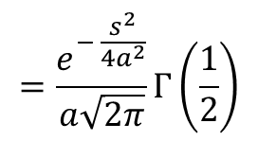
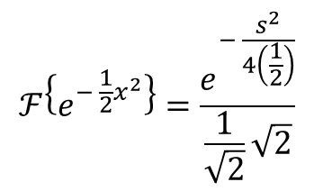
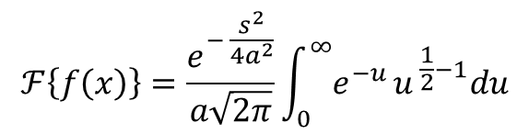

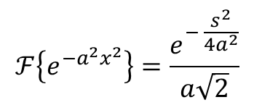
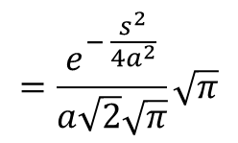
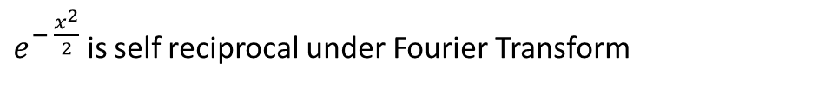
Example cont…
Note
$$ℱ\left\{f\left(x\right)\right\}=\frac{e^{− \frac{s^{2}}{{4a}^{2}}}}{a\sqrt{2π}}\int_{0}^{∞}{e^{−u}}u^{ \frac{1}{2}−1}du$$
Put $a=\frac{1}{\sqrt{2}}$
$$ℱ\left\{e^{− \frac{1}{2}x^{2}}\right\}=\frac{e^{− \frac{s^{2}}{4\left(\frac{1}{2}\right)}}}{\frac{1}{\sqrt{2}}\sqrt{2}}$$
$$=\frac{e^{− \frac{s^{2}}{{4a}^{2}}}}{a\sqrt{2π}}Γ\left(\frac{1}{2}\right)$$
$$=\frac{e^{− \frac{s^{2}}{{4a}^{2}}}}{a\sqrt{2}\sqrt{π}}\sqrt{π}$$
$$ℱ\left\{e^{− \frac{x^{2}}{2}}\right\}=e^{− \frac{s^{2}}{2}}$$
$e^{− \frac{x^{2}}{2}}$ is self reciprocal under Fourier Transform
$$ℱ\left\{e^{{−a}^{2}x^{2}}\right\}=\frac{e^{− \frac{s^{2}}{{4a}^{2}}}}{a\sqrt{2}}$$

Slide 10
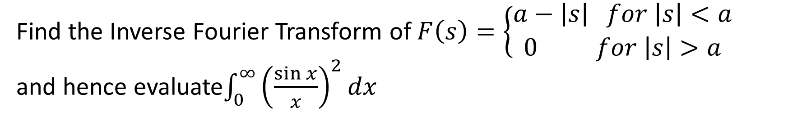
Homework problem
Find the Inverse Fourier Transform of $F\left(s\right)=\left\{\begin{aligned}a−\left|s\right| for \left|s\right|<a \\ 0 for \left|s\right|>a\end{aligned} \right.$ and hence evaluate$\int_{0}^{∞}{{\left(\frac{\sin{x}}{x}\right)}^{2}dx}$

Slide 11


